Slide 1

Chapter 5
Discrete
Probability Distributions

Slide 2
間斷隨機變數及其常用的機率分配
隨機變數
間斷隨機變數的機率分配
常用的間斷
機率分配
二項機率分配
Poisson分配
(波松分配)
隨機變數
的意義
機率函數
二項隨機實驗與二項分配
波松分配
的意義
隨機變數
的種類
期望值與
變異數
期望值與
變異數
期望值與
變異數
標準化
隨機變數
波松分配與
二項分配

Slide 3
Chapter 5 Overview
Introduction
5-1 Probability Distributions
5-2 Mean, Variance, Standard Deviation, and Expectation
5-3 The Binomial Distribution
5-4 Other Types of Distributions

Slide 4
Chapter 5 Objectives
Construct a probability distribution for a random variable.
Find the mean, variance, standard deviation, and expected value for a discrete random variable.
Find the exact probability for X successes in n trials of a binomial experiment.
Find the mean, variance, and standard deviation for the variable of a binomial distribution.
Find probabilities for outcomes of variables, using the Poisson, hypergeometric, and multinomial distributions.

Slide 5
Section 5.1
Probability Distribution

Slide 6
Random Variable (隨機變數)
正正
正反
反正
反反

Slide 7
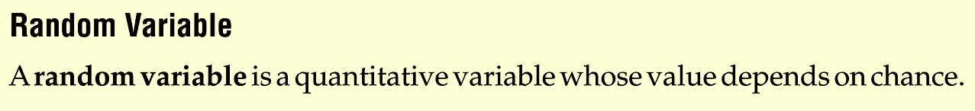
Random Variable
Definition
Notes:
Insert Def 5.1 Random Variable and Def 5.2 Discrete Random variable from page 226

Slide 8
隨機變數的意義與種類

Slide 9
Discrete Random Variables

Slide 10
Continuous Random Variable

Slide 11
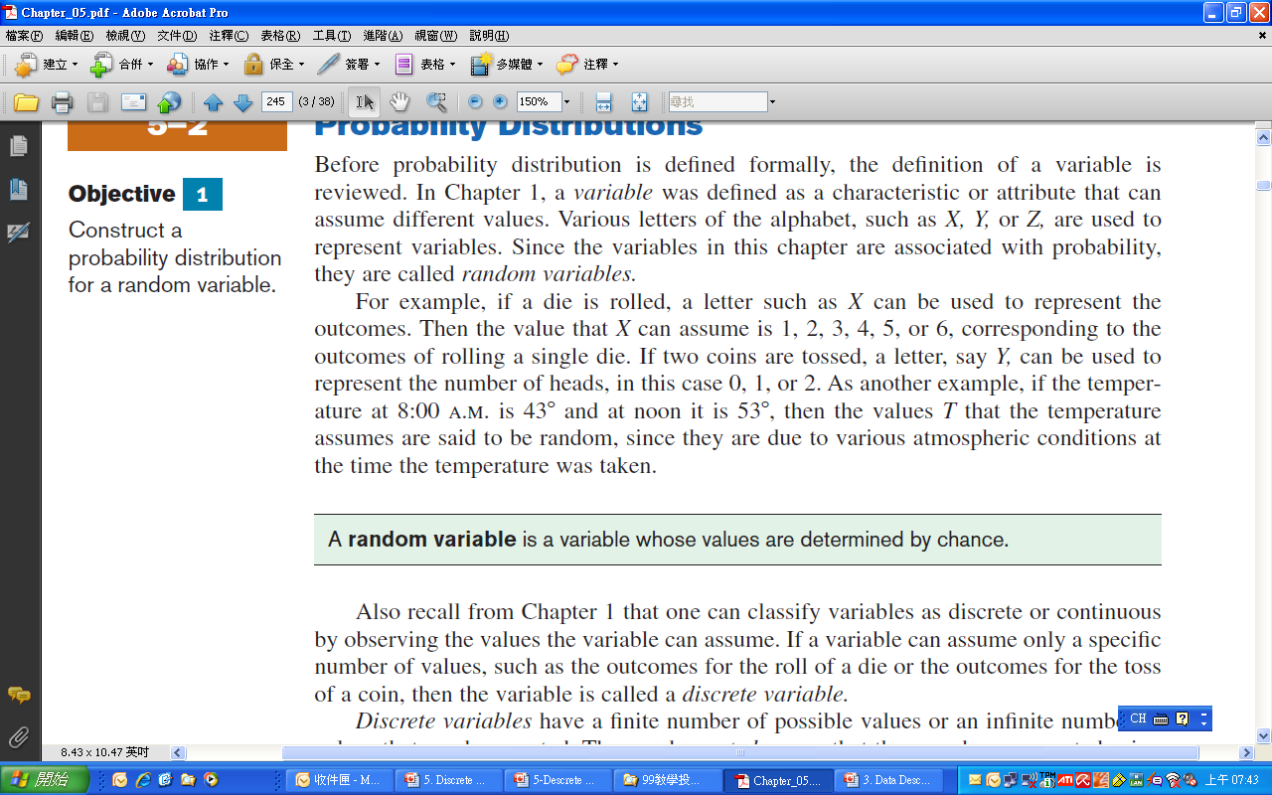
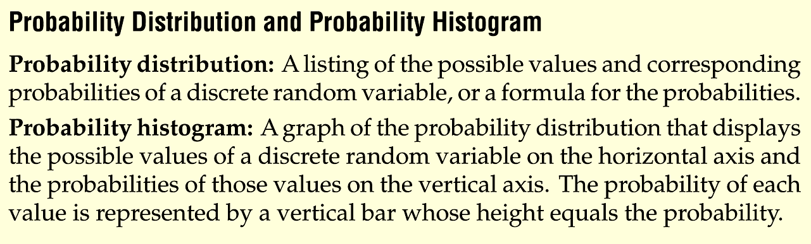
Terminologies

Slide 12

Example: Rolling a Die
Construct a probability distribution for rolling a single die.
Random Variable, X: the outcome

Slide 13
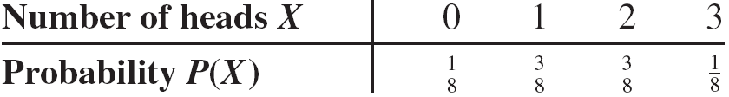
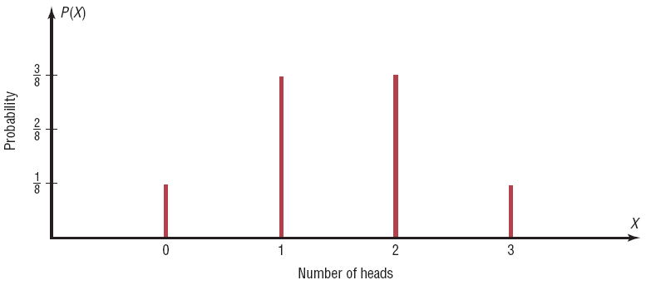
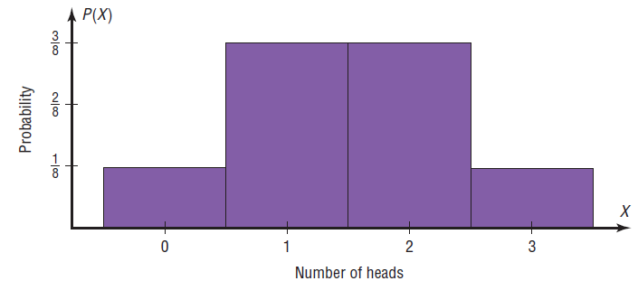
Example: Tossing Coins
Represent graphically the probability distribution for the sample space for tossing three coins.
Random Variable, X: number of heads

Slide 14
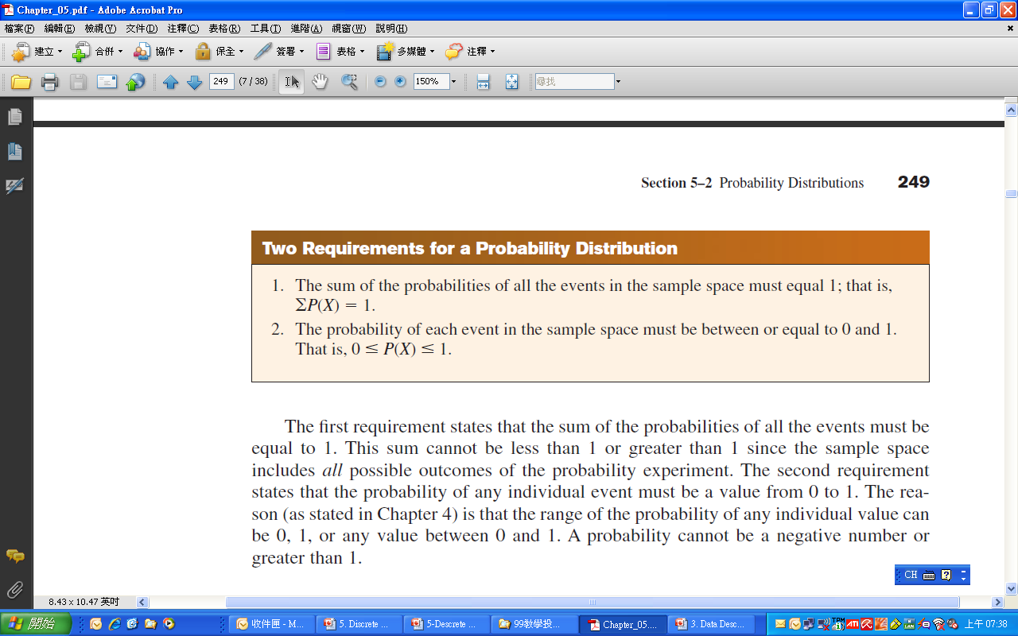

Slide 15
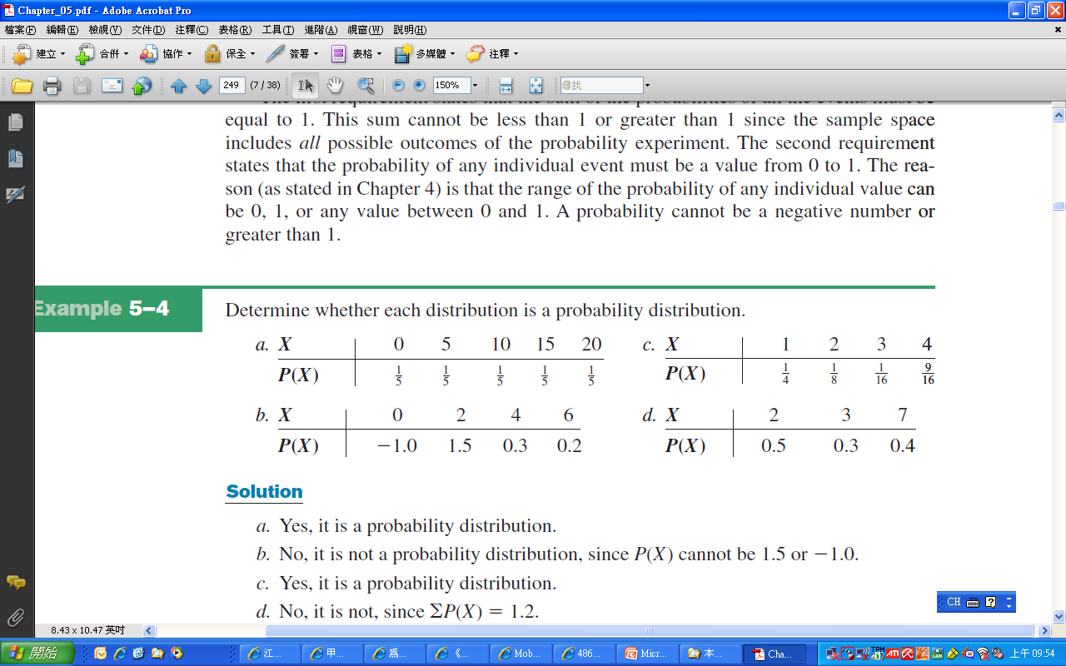
Example 5-4
Determine whether each distribution is a probability distribution

Slide 16
Exercises
Section 5-1 (p.263)
8-10, 13-18, 22, 28, 37

Slide 17
Section 5-2
Mean, Variance,
Standard Deviation, and Expection

Slide 18
Example: Miles Run per Week
Below is a frequency distribution of miles run per week. Find the mean.
Class | Frequency, f | Midpoint, X_{m}
5.5 - 10.5 10.5 - 15.5 15.5 - 20.5 20.5 - 25.5 25.5 - 30.5 30.5 - 35.5 35.5 - 40.5
1
2
3
5
4
3
2
8
13
18
23
28
33
38
Σf = 20

Slide 19
Example 5-5: Rolling a Die
Find the mean of the number of spots that appear when a die is tossed.
.

Slide 20
Example: Children in a Family
In a family with two children, find the mean of the number of children who will be girls.
Number of girls, X | 0 | 1 | 2
Probability, P(X) | 1/4 | 1/2 | 1/4

Slide 21
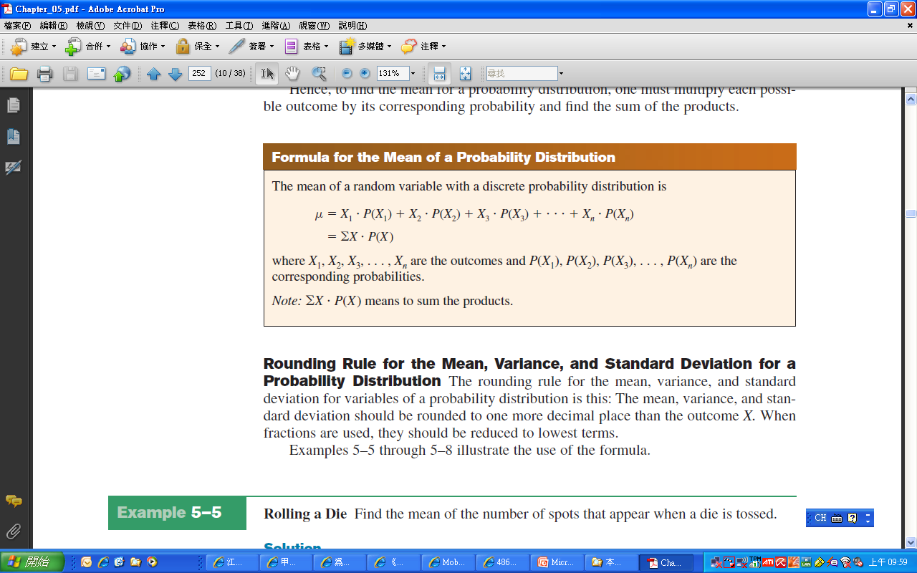
Mean of a probability distribution

Slide 22
Example 5-8: Trips of 5 Nights or More
The probability distribution shown represents the number of trips of five nights or more that American adults take per year. (That is, 6% do not take any trips lasting five nights or more, 70% take one trip lasting five nights or more per year, etc.) Find the mean.

Slide 23
Example5-8: Trips of 5 Nights or More

Slide 24
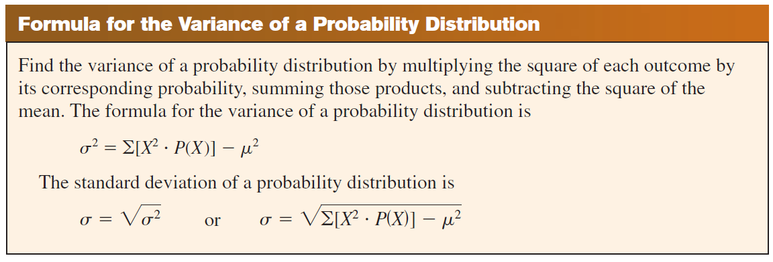
Formula for the Variance

Slide 25

Example 5-11: On Hold for Talk Radio
A talk radio station has four telephone lines. If the host is unable to talk (i.e., during a commercial) or is talking to a person, the other callers are placed on hold. When all lines are in use, others who are trying to call in get a busy signal. The probability that 0, 1, 2, 3, or 4 people will get through is shown in the distribution. Find the variance and standard deviation for the distribution.

Slide 26
Example 5-11: On Hold for Talk Radio

Slide 27
Example: On Hold for Talk Radio
A talk radio station has four telephone lines. If the host is unable to talk (i.e., during a commercial) or is talking to a person, the other callers are placed on hold. When all lines are in use, others who are trying to call in get a busy signal.
Should the station have considered getting more phone lines installed?

Slide 28
Example: On Hold for Talk Radio
The mean number of people calling at any one time is 1.6.
Since the standard deviation is 1.1, most callers would be accommodated by having four phone lines because µ + 2σ would be
1.6 + 2(1.1) = 1.6 + 2.2 = 3.8.
very few callers would get a busy signal since at least 75% of the callers would either get through or be put on hold. (See Chebyshev’s theorem in Section 3–2.)
➔ The four phone lines should be sufficient.

Slide 29
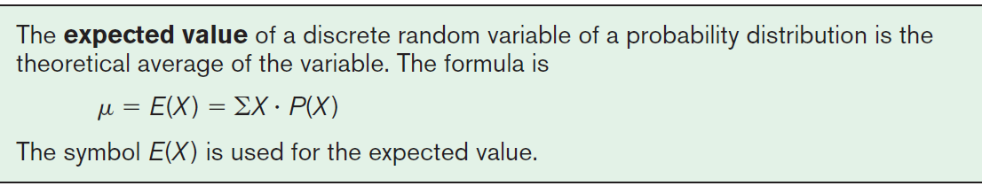
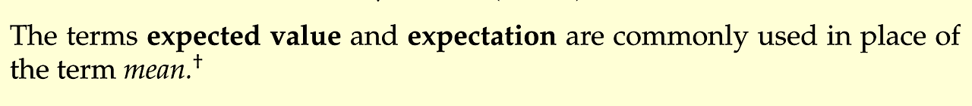
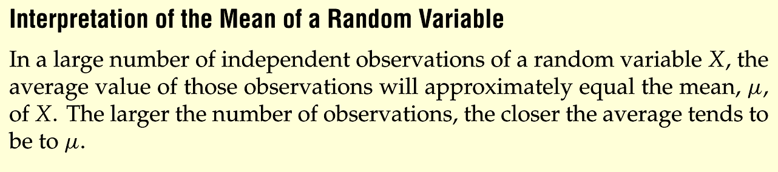
Expectation

Slide 30
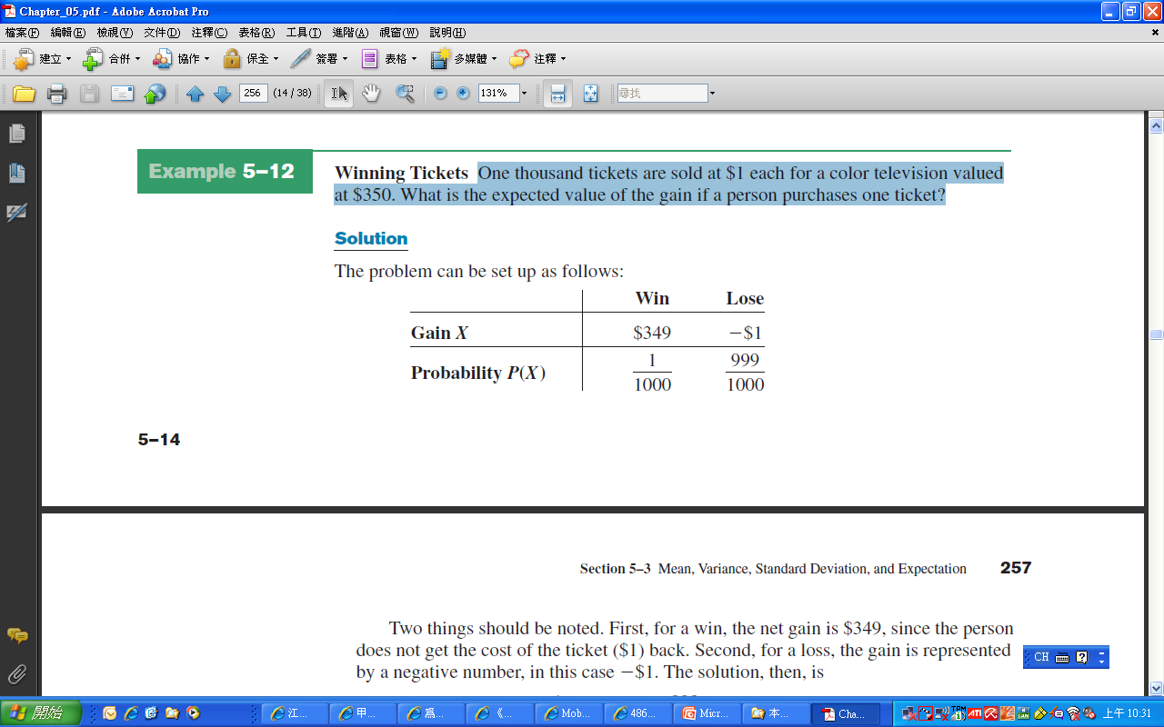
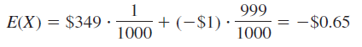
Example 5.12:Winning Tickets
One thousand tickets are sold at $1 each for a color television valued at $350. What is the expected value of the gain if a person purchases one ticket?

Slide 31
Example: Winning Tickets
One thousand tickets are sold at $1 each for four prizes of $100, $50, $25, and $10. After each prize drawing, the winning ticket is then returned to the pool of tickets. What is the expected value if a person purchases two tickets?

Slide 32
Example 5-14: investment

Slide 33
Example
X | 1 | 2 | 3 | 4
P(X) | 0.1 | 0.2 | 0.3 | 0.4
Find E(X) and Var(X).
Let Y=X+2. Find E(Y) and Var(Y).
Let Z=3X+2. Find E(Z) and Var(Z).

Slide 34
Exercises
Section 5-2 (p.272)
1, 2, 5, 10, 11, 15, 16, 23

Slide 35
Section 5-3
The Binomial Distribution

Slide 36
Binomial Coefficients

Slide 37
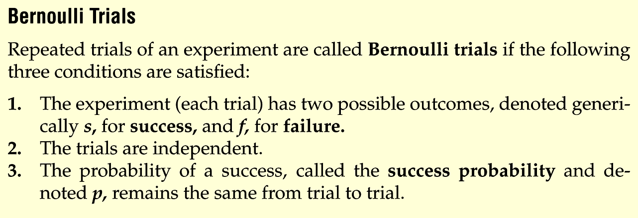
Definition: Bernoulli Trails
Notes:
Change to page 242

Slide 38
The Binomial Distribution
Many types of probability problems have only two possible outcomes or they can be reduced to two outcomes.
Examples include: when a coin is tossed it can land on heads or tails, when a baby is born it is either a boy or girl, etc.

Slide 39
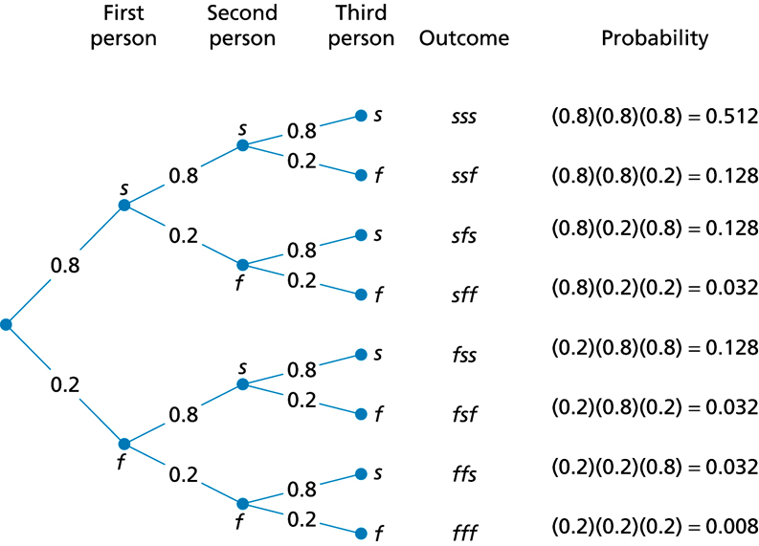
Example: Binomial Distribution
Notes:
Change to page 244

Slide 40
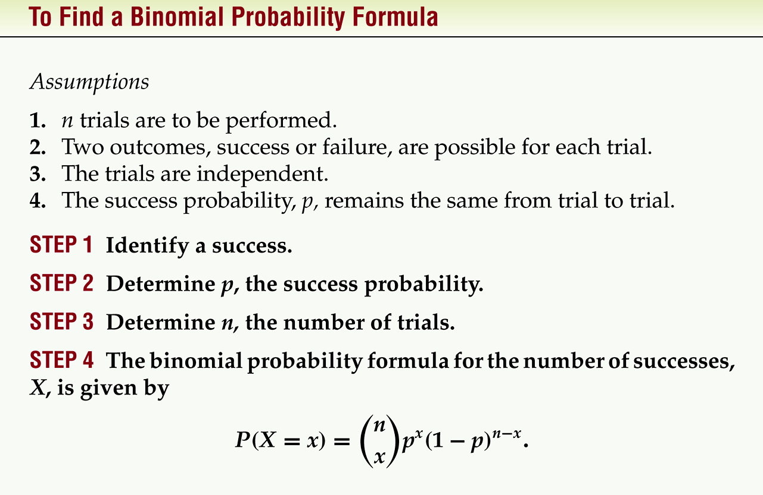
(Bernoulli Trails)
f (x) =
Notes:
Change to page 246

Slide 41
Notation
P(S)
P(F)
p
q
P(S) = p
n
X
Note that X = 0, 1, 2, 3,...,n
The symbol for the probability of success
The symbol for the probability of failure
The numerical probability of success
The numerical probability of failure
and P(F) = 1 – p = q
The number of trials
The number of successes

Slide 42
Example 5-15
Decided whether each experiment is a binomial experiment. If not, state the reason why.
Selecting 20 university students and recording their class rank.
Selecting 20 students from a university and recording their gender.
Drawing five cards from a deck without replacement and recording whether they are red or black cards.
Selecting five students from a large school and asking them if they are on the dean’s list.
Recording the number of children in 50 randomly selected families.

Slide 43
Example 5.16: Tossing Coins
A coin is tossed 3 times. Let X denotes the outcome of number of head. Find the probability of getting exactly two heads.

Slide 44
Example 5-17: Survey on Doctor Visits
A survey found that one out of five Americans say he or she has visited a doctor in any given month. If 10 people are selected at random, find the probability that exactly 3 will have visited a doctor last month.

Slide 45
Example 5-18: Survey on Employment
A survey from Teenage Research Unlimited (Northbrook, Illinois) found that 30% of teenage consumers receive their spending money from part-time jobs. If 5 teenagers are selected at random, find the probability that at least 3 of them will have part-time jobs.

Slide 46
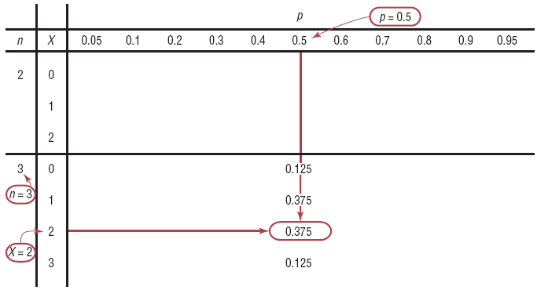
Example 5-19: Tossing Coins
A coin is tossed 3 times. Find the probability of getting exactly two heads, using Table B.

Slide 47
Example:二項分配機率—查表
B(3; 5, 0.3)
B(15; 20, 0.8)

Slide 48
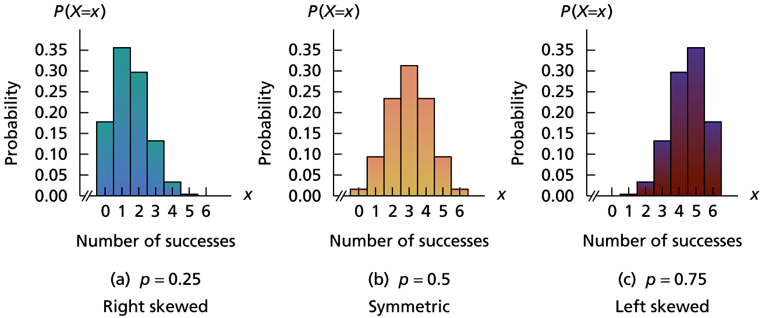
Figures
Notes:
Change to page 248

Slide 49
Example
Public Opinion reported that 5% of Americans are afraid of being alone in a house at night. If a random sample of 20 Americans is selected, find these probabilities by using the binomial table.
a. There are exactly 5 people in the sample who are afraid of being alone at night.
b. There are at most 3 people in the sample who are afraid of being alone at night.
c. There are at least 3 people in the sample who are afraid of being alone at night.

Slide 50
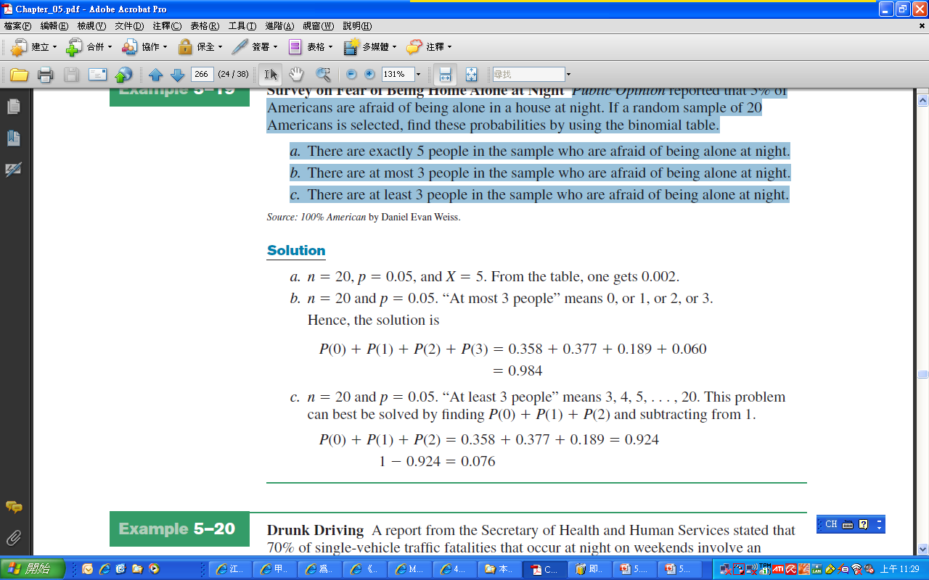
Example

Slide 51
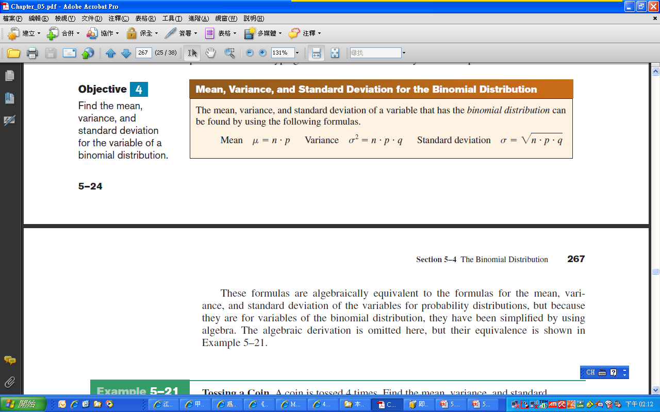
The Binomial Distribution

Slide 52
Probabilities of B(x; n, p)
根據內政部粗略估算20歲成年人中，有80%的機率會存活至65歲以上，如今有甲、乙、丙三人現年20歲，設隨機變數X:存活至65歲以上的人數，試求下列機率:
洽有2人存活至65歲以上
至少一人
X的機率分配

Slide 53
公式推導—Mean
f (x) =

Slide 54
公式推導—Variance
f (x) =

Slide 55
Example 5-23: Rolling a Die
An 8-sided die (with the numbers 1 through 8 on the faces) is rolled 560 times. Find the mean, variance, and standard deviation of the number of 7s that will be rolled. (p.282, one mistake)

Slide 56
Example 5-24: Likelihood of Twins
The Statistical Bulletin published by Metropolitan Life Insurance Co. reported that 2% of all American births result in twins. If a random sample of 8000 births is taken, find the mean, variance, and standard deviation of the number of births that would result in twins.

Slide 57
Mean & Standard Deviation of Binomial distribution
根據一項研究調查顯示，智慧型手機的普及率約60%，如今隨機抽取甲、乙、丙三人，設隨機變數X：智慧型手機的使用人數，試求X的平均值與標準差。

Slide 58
Exercises
5-3 (p.283)
1, 2, 4, 5, 13, 15, 17, 28, 29, 32, 33, 34

